Slide 1
Qb2_User_App Manual
V1.2

Slide 2
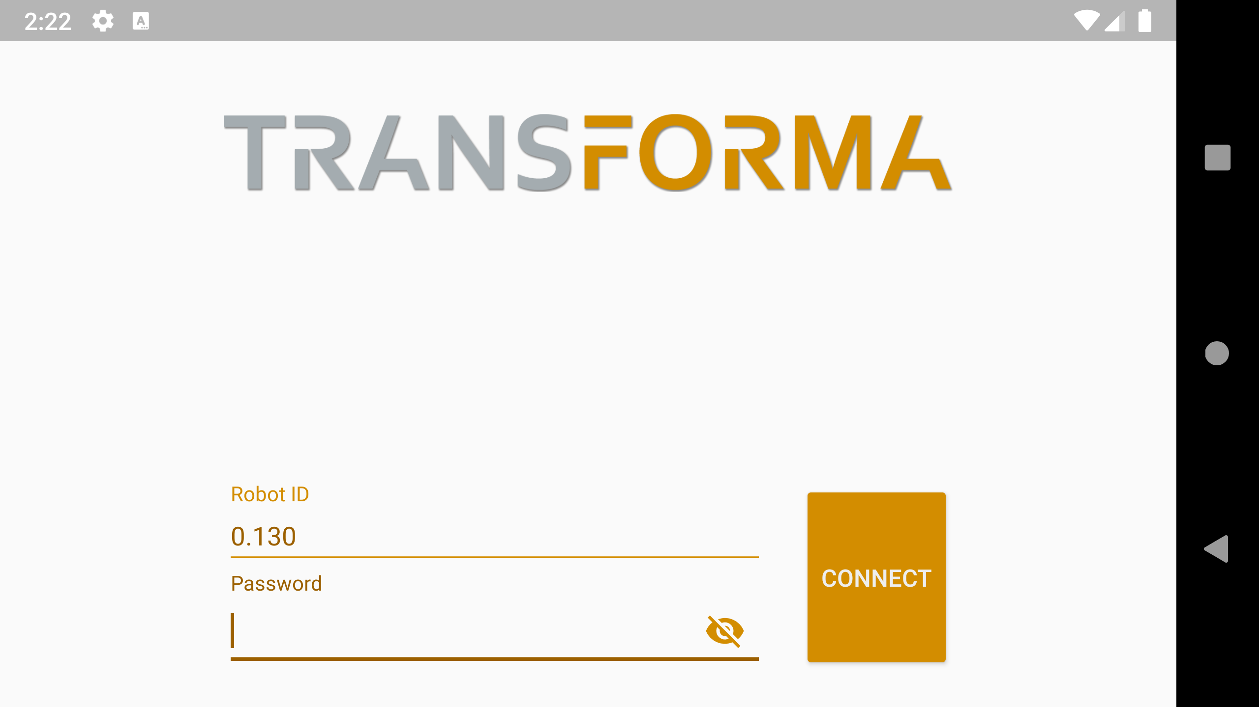
Login Page
Enter 0.130 when connected to robot Wi-Fi, and leave password blank

Slide 3
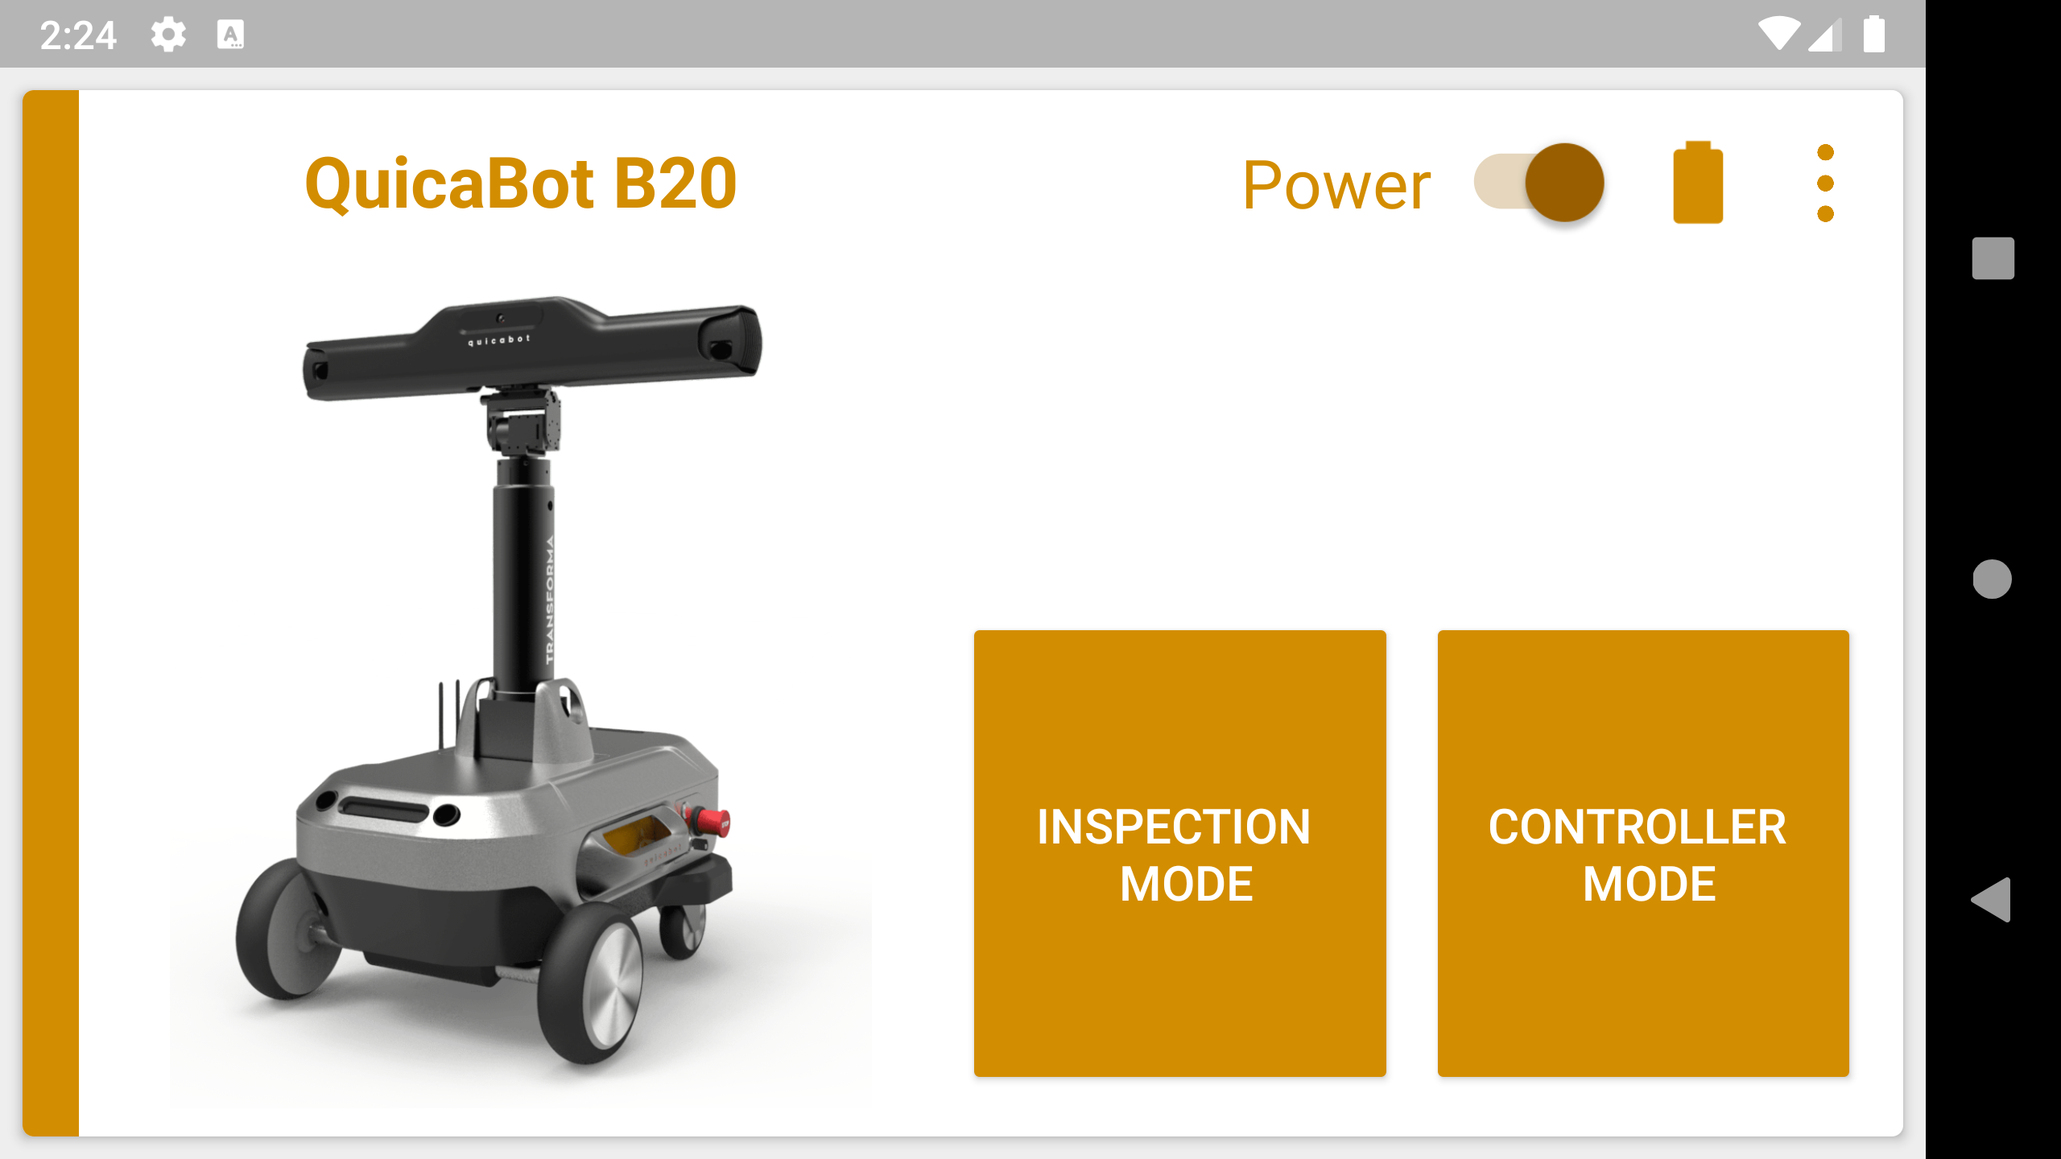
Main Page
Turn off robot
You can turn off robot when everything is finished
Enter inspection mode when necessary
Other buttons are not so relevant right now
Avoid going back to home as android may kill process.
Clicking back button alerts you whether you want to exit the app
Main Inspection Mode

Slide 4
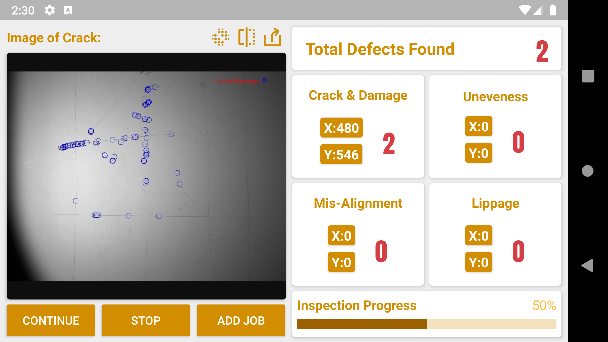
Inspection mode
① Enter Point Cloud View
② Toggle which image you want to show
③ Generate report to send to email
④ When adding job:
Single: Do a quick scan at current position
Wall Column: Do a series of column scan.
Auto: Do a series of large area scan in front of you
Floor: Scan the floor around you
⑤ Remember to Click stop and don’t just click back button as the inspection process would continue in the background
Clicking this would enter Inspection Summary (Under Development)
1
2
3
Defects type
Position
Count
Stop button allows you to clear defects count and stop receiving data from robot
Can add Inspection Job here, there are 4 types in total.
5
4

Slide 5
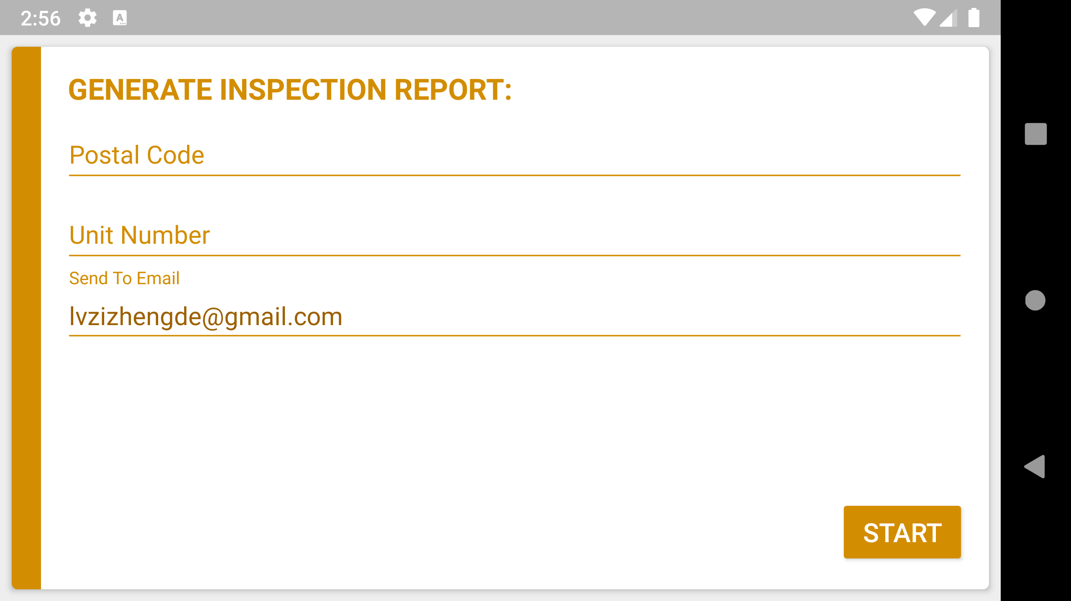
Report Generation
Easy to use page, sending report to specific email address

